Slide 1

Quant Week 6
3/21/24
Notes:
Complete

Slide 2

Agenda
Icebreaker Question
Brainteasers
Zetamac?
VWAP & TWAP
Project

Slide 3
Ice Breaker
Favorite place to eat in Ann Arbor

Slide 4
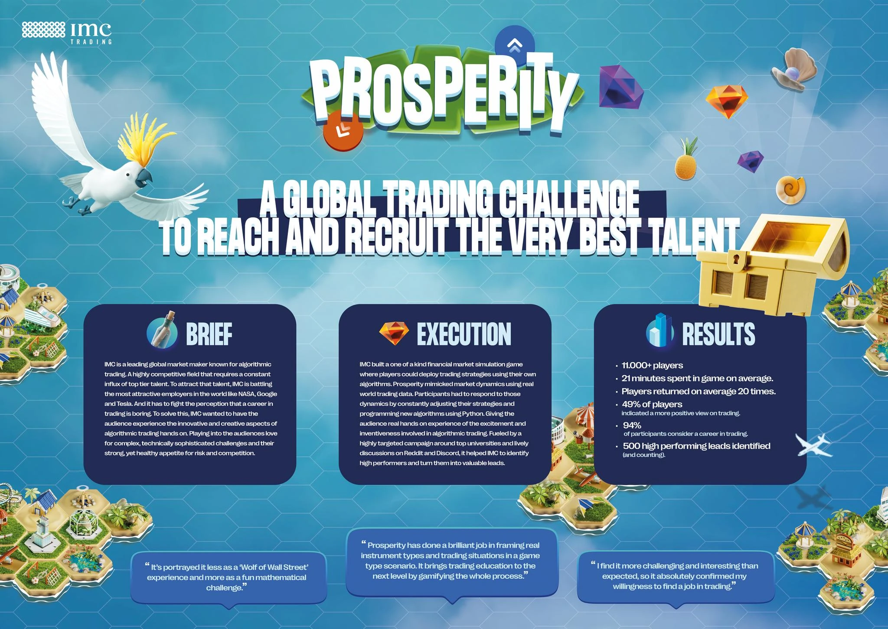

IMC Sponsorship!
Referal Code: 3MRLW8

Slide 5
IMC Sponsorship!
Sophomores, apply to IMC Launchpad:
https://careers.imc.com/us/en/launchpad
Great opportunity to learn
If you get in, IMC gives you a final round internship interview
IMC Event
Time/Date TBD

Slide 6
Brain Teaser - Card Game
You are playing a simple card game in which you and the dealer both draw a card.
You win if your card is higher than theirs
You lose if your card is lower than or equal to theirs
What is the probability that you win?

Slide 7
Brain Teaser - Card Game - Solution
What is the probability that you win?
Each card has a 1/13 chance of being picked
1/13 * (0+4/51+8/51+ . . . +48/51) = 4/(13*51)*(0+1+ . . . + 13) = 4(13*51)*12*13/2
= 8/17
Simpler way:
E₁ = your card is higher
E₂ = your card is the same
E₃ = your card is lower
P(E₁) = P(E₃)
P(E₁) + P(E₂) + P(E₃) = 1
Find P(E₂) and then you can calculate it
P(E₂) = 3/51 = 1/17
2*P(E₁) + 1/17 = 1
P(E₁) = 8/17

Slide 8
Schedule-Based Single Order Algorithms
Notes:
Idea:
We’ll write the platform to make and conduct trading strategies.
You guys will write and implement the strategies, test them on prior data
Alternate for more software-oriented people you guys could also make the platform
We can do this in python/C++, if python use numPy and Yahoo Finance data
Use matplotlib plot graphs, show that in pdf/md/html file through github

Slide 9
Let’s say you are a trader and your firm wants to buy (or sell) a large volume of a single stock.
A large volume in this context is one that will change the price

Slide 10
Order Book Example, Market Order of 1000
Bid (Volume) | Price | Ask (Volume)
 | 100.05 | 350
 | 100.04 | 450
 | 100.03 | 200
 | 100.02 | 150
 | 100.01
120 | 100.00
180 | 99.99

Slide 11
Order Book Example, Market Order of 1000
Bid (Volume) | Price | Ask (Volume)
 | 100.05 | 350 (150 SOLD)
 | 100.04 | 450 (SOLD)
 | 100.03 | 200 (SOLD)
 | 100.02 | 150 (SOLD)
 | 100.01 | 50 (SOLD)
120 | 100.00
180 | 99.99

Slide 12
Order Book Example
Bid (Volume) | Price | Ask (Volume)
 | 100.05 | 200
 | 100.04
 | 100.03
 | 100.02
 | 100.01
120 | 100.00
180 | 99.99

Slide 13
As you can see, the best ask when the market order was placed was 10.01.
Some orders went through at this price, but not all of them.
Some went through as high as 10.05.

Slide 14
Order Book Example
Bid (Volume) | Price | Ask (Volume)
 | 100.01
 | 120.00 | 200
 | ….
 | 100.10 | 50
 | 100.09 | 50
 | 100.08 | 50
 | 100.07 | 60
 | 100.06 | 40
 | 100.05 | 50
 | 100.04 | 200
 | 100.03 | 100
 | 100.02 | 100
 | 100.01 | 100
120 | 100.00
180 | 99.99

Slide 15
Order Book Example
Bid (Volume) | Price | Ask (Volume)
 | 120.01
 | 120.00 | 200 (SOLD)
 | ….
 | 100.10 | 50 (SOLD)
 | 100.09 | 50 (SOLD)
 | 100.08 | 50 (SOLD)
 | 100.07 | 60 (SOLD)
 | 100.06 | 40 (SOLD)
 | 100.05 | 50 (SOLD)
 | 100.04 | 200 (SOLD)
 | 100.03 | 100 (SOLD)
 | 100.02 | 100 (SOLD)
 | 100.01 | 100 (SOLD)
120 | 100.00
180 | 99.99
For a larger example, if there is not much demand at all, transacting may lead to much higher prices.
Here some orders are placed at $120 because the market is “thin”
thin means relatively few buyers/sellers

Slide 16
Order Book Example, LimitOrder of 1000
Bid (Volume) | Price | Ask (Volume)
 | 100.05 | 350
 | 100.04 | 450
 | 100.03 | 200
 | 100.02 | 150
 | 100.01
120 | 100.00
180 | 99.99

Slide 17
Order Book Example, Limit Order of 1000
Bid (Volume) | Price | Ask (Volume)
 | 100.05 | 350
 | 100.04 | 450
 | 100.03 | 200
 | 100.02 | 150
 | 100.01 | 50
1,120 (1,120 Yours) | 100.00
180 | 99.99

Slide 18
People will be able to see that you placed this order, and others will try to “front run” your order
Others know this order is likely to make prices go up so others will try to buy
They see your order exists and has not transacted yet, so they will try to beat you to it by buying one cent above you
This makes YOU lose out on profits!

Slide 19
How to avoid these things
Use a combination of both market and limit orders
Sell over time
TWAP - Time-Weighted Average Price
Buy/Sell a handful of the stock in intervals
This way others won’t see your large limit orders, and market orders will (hopefully) get better prices

Slide 20
TWAP & VWAP
TWAP - Time-Weighted Average Price
VWAP - Volume-Weighted Average Price
Match the intervals to corresponding trading volume

Slide 21
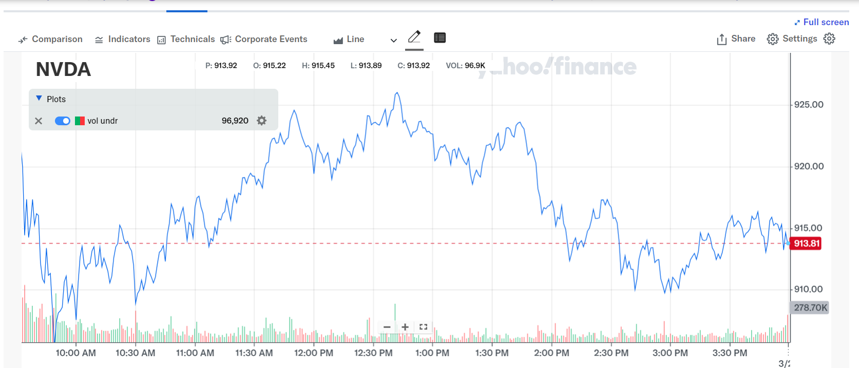

Slide 22
Project Discussion/Work Time
Notes:
Idea:
We’ll write the platform to make and conduct trading strategies.
You guys will write and implement the strategies, test them on prior data
Alternate for more software-oriented people you guys could also make the platform
We can do this in python/C++, if python use numPy and Yahoo Finance data
Use matplotlib plot graphs, show that in pdf/md/html file through github

Slide 23
Current Environment
As of right now, we’ll use Google Drive/Colab
.py files stored in the drive, need to be implemented
.ipynb file for driver, also needs to be implemented
Hoping to move to git/github and conda environments soon
Review the guide and setup your python and conda environments accordingly
If you get stuck, I will be available to help out next week outside of our normal meeting

Slide 24
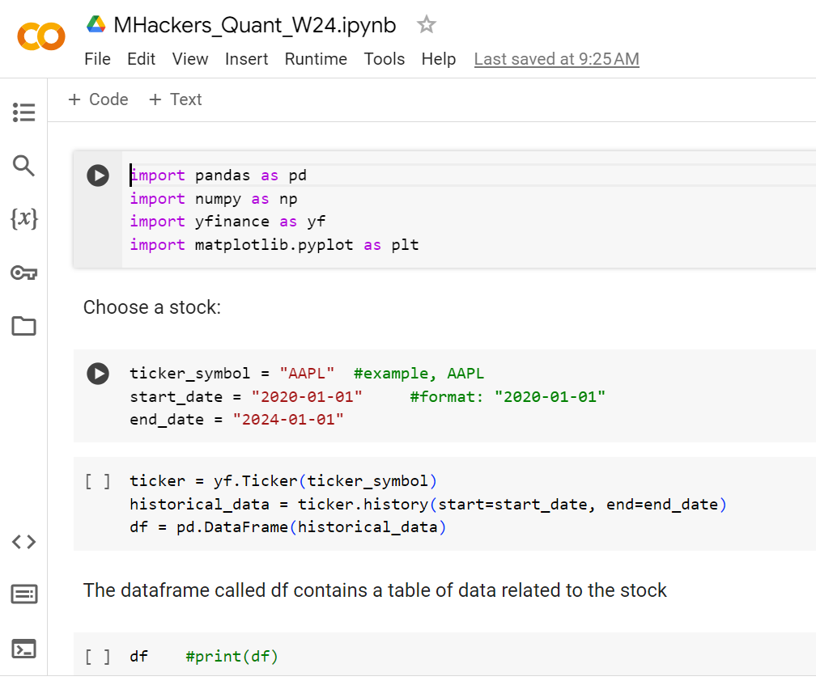
Google Colab
Located in Quant Drive
Copy this and put it in your drive
Sample finance
commands/functions,
What we’ve been working on

Slide 25
algorithm.py
Base class for algorithms
Other algorithms we develop will inherit from this
Necessary to standardize input/output so we can backtest many types of algos
Member variables
portfolio: dictionary of (Ticker, # of shares)
cash: amount of cash on hand (can be negative)
Member functions:
buy(Ticker): increases ticker value, decreases cash
sell(Ticker): decreases ticker value, increases cash

Slide 26
backtest.py
Backtest class contains functions for running algorithms
run(algorithm, startDate, endDate): runs the algorithm on a particular date range
Logs relevant information, like when trades are made, portfolio value at each time step
graphReturns(): creates a plot of returns vs. time (using matplotlib)
calculateVol(): calculates the volatility of the algorithm
calculateSharpe(): calculates the Sharpe ratio of the algorithm (risk v. return)

Slide 27
Attendance Form
This one
Link to Onboarding Document, Slack and Team Folder
https://tinyurl.com/2fk3aemj
https://docs.google.com/document/d/1oA2q-qjPCw1bY79zWf1LtpeN_da65L0ntnxzCQSsJRc/edit?usp=sharing

